Slide 1
"About 33.6% (162,063 persons) of the working-age (15-64 yr) population are economically inactive; more than half (59.1%) are females, while 40.9% are males. "

Slide 2
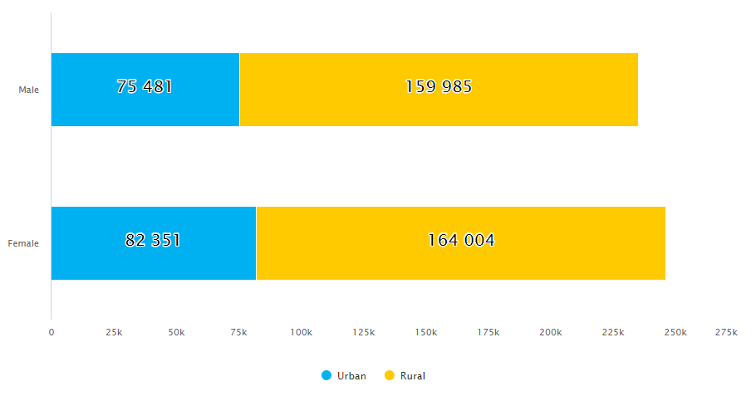
Working-Age Population
Sex | Urban |  | Rural |  | Total
 | Number | Percent | Number | Percent | Number | Percent
Male | 75,481 | 47.8 | 159,985 | 49.4 | 235,466 | 48.9
Female | 82,351 | 52.2 | 164,004 | 50.6 | 246,354 | 51.1
Both Sex | 157,832 | 100 | 323,989 | 100 | 481,821 | 100
2/3rd of the population in Bhutan stays in rural areas, where number of females is slightly more among working age population (15-64 years)

Slide 3
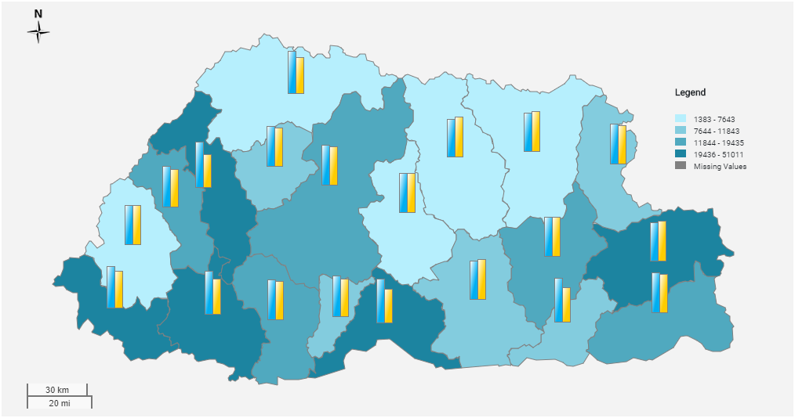
Economically Active Population in Dzongkhags
Male
Female

Slide 4
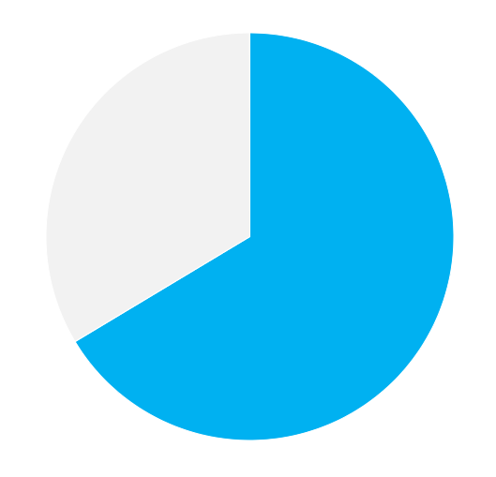
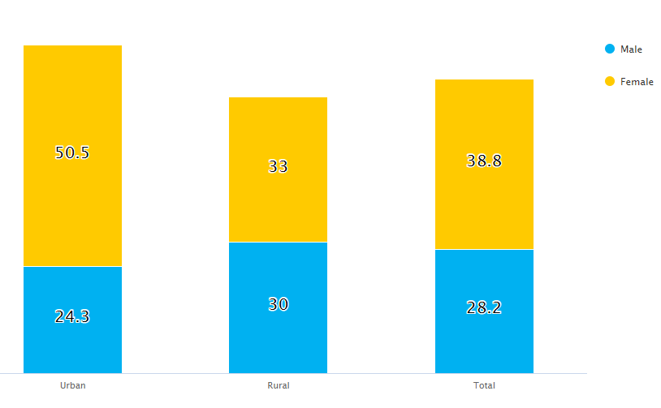
Most of the population in Bhutan is of working-age group
66.4%
Out of which, 1/3rd (33.6%) population are economically inactive.
Most of them are females

